Slide 1


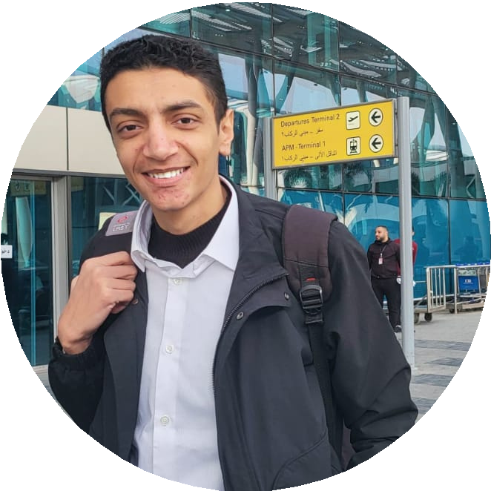




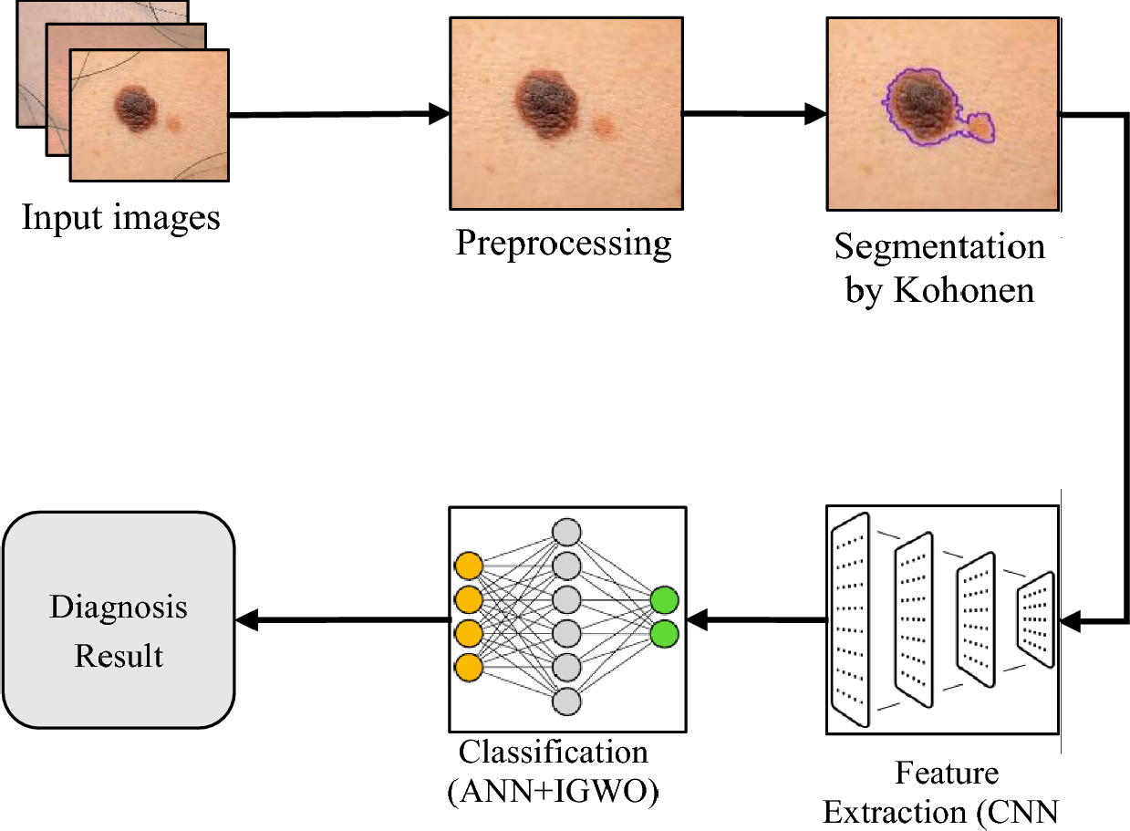
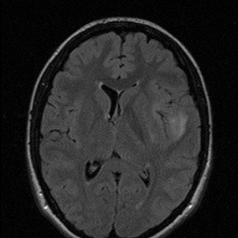


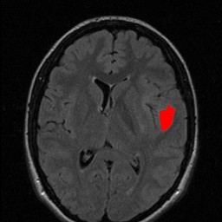
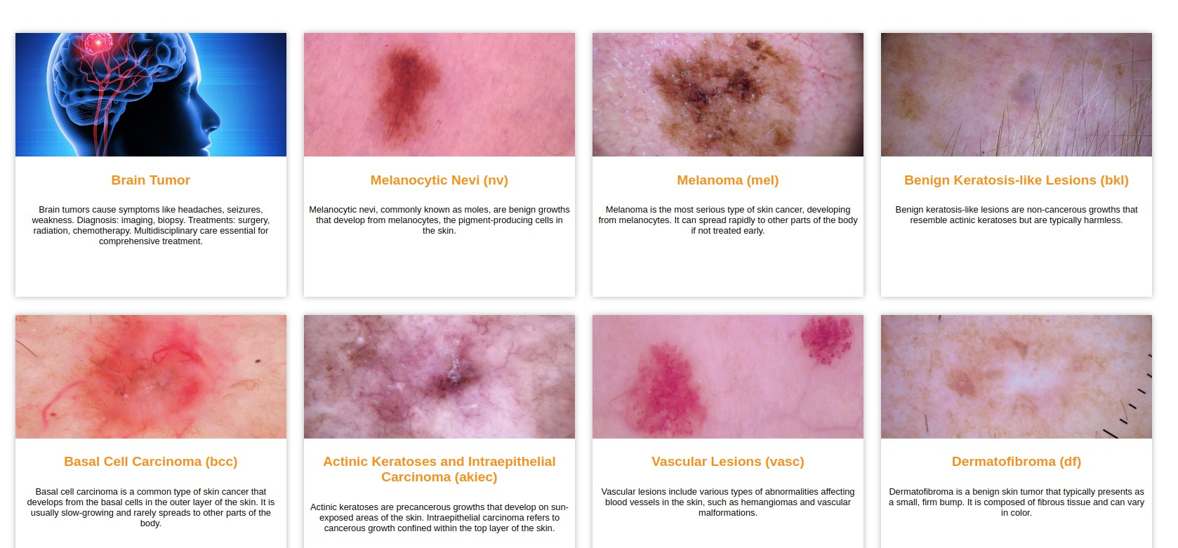
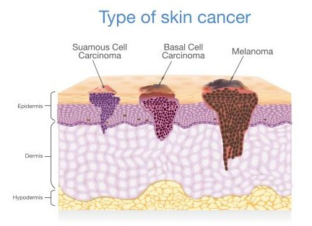
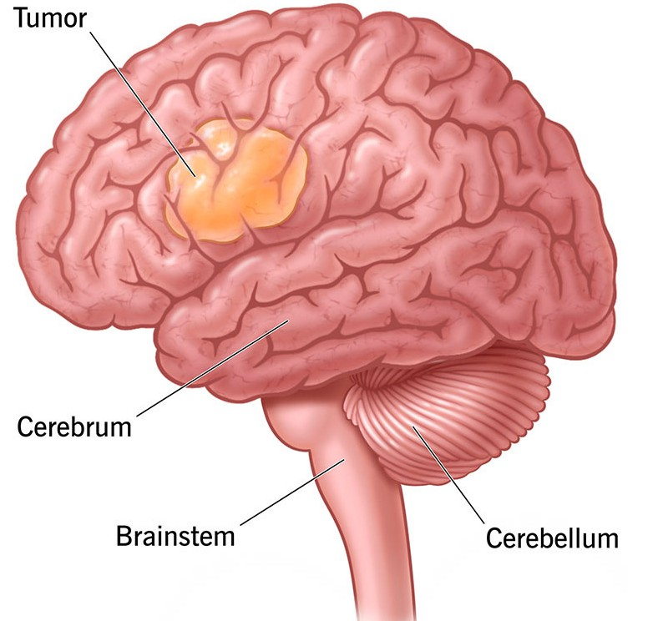
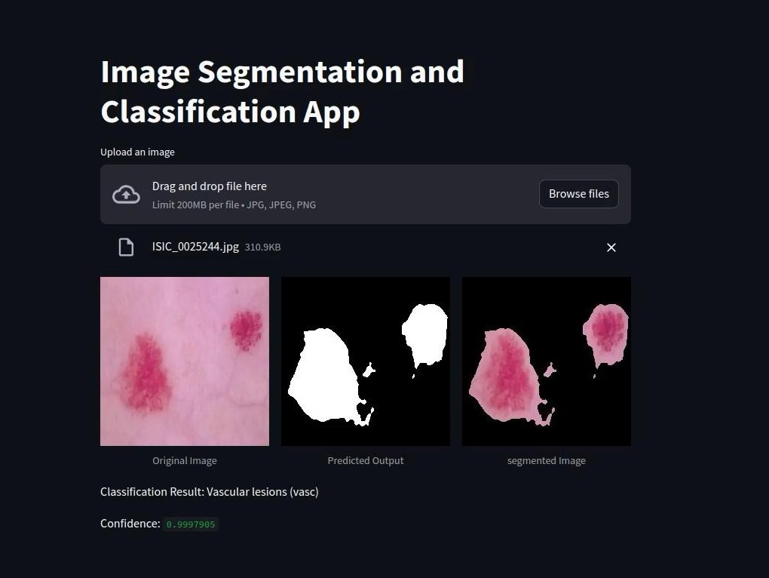
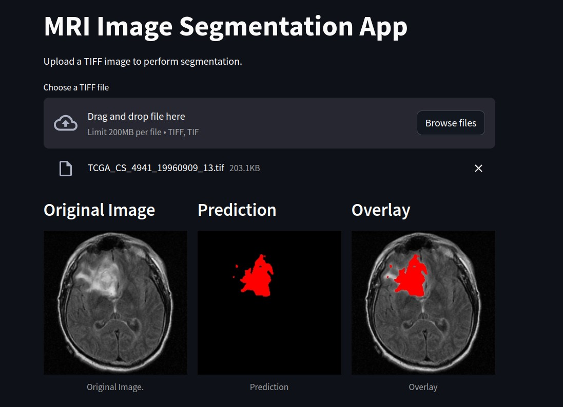
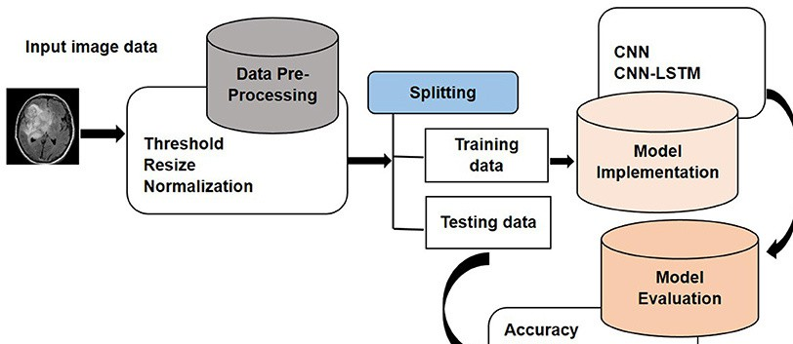
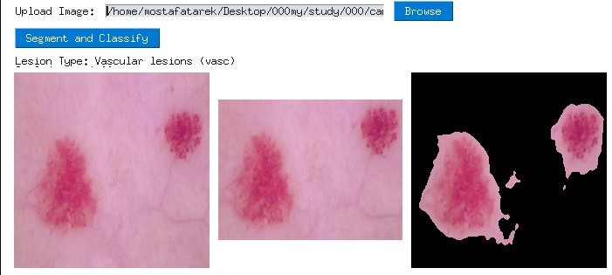
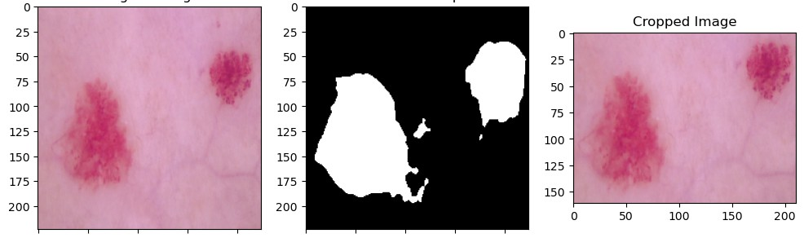
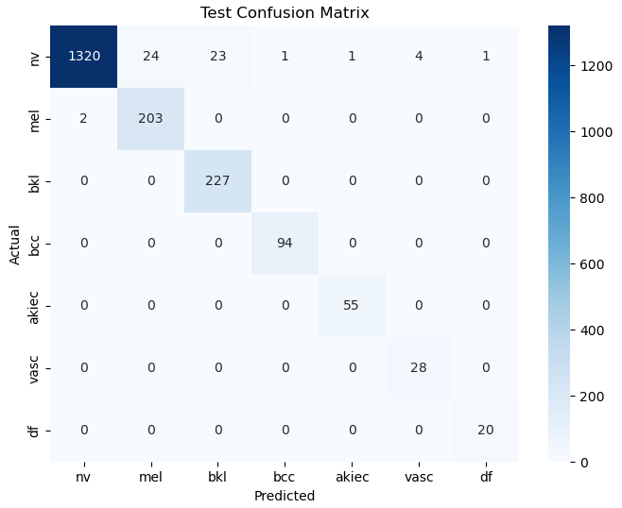
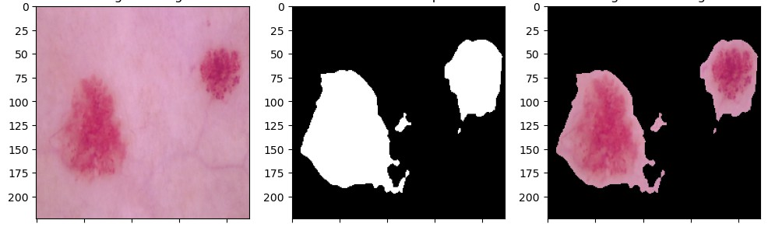
Misr University for Science & Technology (MUST) Department Of Artificial Intelligence
Academic year, 2023-2024
Graduation Project: Cancer Detection using a Deep Learning Approach
Mostafa Tarek 94071
Mohamed Ezz 94303
Abd El-Rahman Ahmed 94218
Amr Samir 90369
Nour Ehab 90330
Under supervision of Professor: Prof.Rania Elgohary
Teaching Assistant:
T.A. Shaimaa Bahaa
T.A. Shereen Youssef
DR. Mohamed Badawi
ABSTRACT
The results for brain cancer segmentation are promising. The best-trained segmentation model had an impressive 99.8% accuracy, 91.69% Dice coefficient, and 85.26% IOU. The test data was 99.8% accuracy, 90.67% Dice coefficient, and 83.14% IOU. Original Image Ground Truth Prediction Overlay Fig. 7: Sample Brain Predictions. The Platform Fig. 7: Categories Overview for The Website. Our Desktop and Streamlit APP Fig. 8: Sample Prediction from Platforms.
Conclusion
This project confirms that CNNs boost skin cancer diagnosis accuracy. Leveraging datasets like HAM10000 and PH2, plus advanced preprocessing, yields promising outcomes. Integrating a U-NET model improves lesion boundary delineation. Additionally, extending this approach to brain tumor segmentation further demonstrates the versatility of AI-driven methods in transforming healthcare, offering precise and accessible diagnosis across different medical domains
Acknowledgement
Skin cancer and brain tumors are significant health threats globally, demanding effective early detection and intervention strategies. By utilizing artificial intelligence (AI) in cancer detection, innovative approaches are transforming traditional methods. AI algorithms aid in the timely identification and characterization of skin lesions and brain abnormalities, enhancing diagnostic accuracy and treatment planning.
Introduction
Fig. 3: Skin Cancer localization and detection System.
Skin cancer and brain tumors are global health concerns, requiring understanding and prevention. AI offers promise in detection, treatment, and prevention. Skin cancer includes types like BCC, SCC, and melanoma [1], often diagnosed late. Brain tumors, less common but serious, can affect essential brain functions. AI helps in early detection of skin cancer through photo analysis and in brain tumor detection through medical imaging.
3. Web Development:
Build a website to host the segmentation and classification models for skin cancer analysis.
Integrate user-friendly interfaces for uploading skin images, displaying segmentation results, and providing classification predictions.
Implement backend functionality to handle image processing requests and model inference.
4. Desktop Application:
Develop a desktop application for offline use,
--
allowing users to segment and classify skin lesions locally on their devices.
Ensure cross-platform compatibility and intuitive user interface design for ease of use.
5. Model Evaluation and Optimization:
Evaluate the performance of both segmentation and classification models using appropriate
Fig .1: Skin Cancer Signs & Symptoms. Fig .2: Brain Tumor Signs.
Problem definition
Skin cancer affects approximately 5.4 million cases globally, with an incidence rate of 3.1% of all cancer cases worldwide [2]. Brain tumors, on the other hand, constitute around 2.3% of all cancer diagnoses globally, affecting approximately 700,000 people each year [3]. So, Detecting skin cancer and brain tumors accurately is essential for effective treatment. Current methods have limitations, such as inconsistent manual diagnosis for skin cancer and difficulty in accurately delineating tumor boundaries for brain tumors, delaying treatment planning. This project aims to develop AI-based segmentation models for both conditions to automate localization, improve accuracy, and expedite treatment planning, ultimately benefiting patients and reducing healthcare burdens.
metrics such as Intersection over Union (IoU) for segmentation accuracy and precision-recall
curves for classification performance.
Fig. 4: Brain Tumor Segmentation System.
Methodology
Results
Data Collection::
Gather diverse datasets of skin cancer images and brain tumor medical imaging scans.
Curate and preprocess the data, including image augmentation techniques to enhance model generalization.
Model Development:
Design and train a segmentation model for skin cancer localization using the deep learning architecture U-Net. Implement a classification model to categorize localized skin lesions into different cancer types, utilizing convolutional neural networks (CNNs).
Develop a segmentation model for brain tumor localization in medical imaging scans.
The results for skin cancer classification are promising. The best-trained classification model had an impressive 99.5% accuracy, 99.5% precision, and 99.5% recall. The test data was 97.204% accuracy, 97.5% precise, and 97.2% recall. In addition, the U-NET model performed admirably in skin cancer lesion segmentation, with segmentation metrics such as accuracy of 96.68%, precision of 95.39%, recall of 94.24%, Dice coefficient of 93.58%, and IOU of 97.09% for training data and an accuracy of 96.14%, precision of 93.44%, recall of 94.09%, Dice coefficient of 92.55%, and IOU of 96.43% for testing data.
We express our sincerest gratitude to the Dean of our faculty, Prof. Rania Elgohary, for her unwavering dedication to the growth and success of our academic community. Additionally, we are immensely thankful to our instructor, Dr. Mohamed Badawi, and our Teaching Assistants, T.A. Shaimaa Bahaa and T.A. Shereen Youssef. Your guidance, expertise, and unwavering commitment have been invaluable in shaping our learning journey.
Fig. 5: Sample Skin Predictions.
Fig. 6: Confusion Matrix for Test Data.
References
Y Wang, Y Wang,J Cai, TK Lee, C Miao, ZJ Wang. Ssd-kd: A self-supervised diverse knowledge distillation method for lightweight skin lesion classification using dermoscopic images. Medical Image Analysis. 2023 Feb 1;84:102693.
S Panda, AS Tiwari, MR Prusty. Comparative study on different Deep Learning models for Skin Lesion Classification using transfer learning approach. International Journal of Scientific and Research Publications. 2021;11(1):219-32.
Wang B, Geng P, Li T, Yang Y, Tian X, Zhang G, Zhang X. A deep model towards accurate boundary location and strong generalization for medical image segmentation. Biomedical Signal Processing and Control. 2024 Feb 1;88:105623.

